Slide 1
Gaussian Processes
NEIL LAWRENCE
Robotics Offsite, Berlin
Notes:
Challenges
Introduce self
Alphago impressive but requires heavy compute.
More games of go than any human
And yet still Lee managed to win a match.

Slide 2











$\text{g}\left(x\right)$
${\text{f}}_{1}(x)$
${\text{f}}_{2}(∙)$
${\text{f}}_{3}(∙)$
${\text{f}}_{4}(∙)$
${\text{f}}_{5}(∙)$
${\text{f}}_{6}(∙)$
${\text{f}}_{7}(∙)$
${\text{f}}_{8}(∙)$
${\text{f}}_{9}(∙)$
$\text{g}\left(x\right)={\text{f}}_{9}\left({\text{f}}_{8}\left({\text{f}}_{7}\left({\text{f}}_{6}\left(⋯\right)\right)\right)\right)$

Slide 3





$x$
$$\text{ϕ}\left({\text{W}}_{1}x_{1}\right)$$
$$\text{ϕ}\left({\text{W}}_{2}h_{1}\right)$$
$$\text{ϕ}\left({\text{W}}_{3}h_{2}\right)$$
$$y$$
Yes
No

Slide 4
$x$
$$\text{ϕ}\left({\text{W}}_{1}x_{1}\right)$$
$$\text{ϕ}\left({\text{W}}_{2}h_{1}\right)$$
$$\text{ϕ}\left({\text{W}}_{3}h_{2}\right)$$
$$y$$
Yes
No

Slide 5
The Data are Not Enough
Four pillars:
Deterministic/Stochastic
Mechanistic/Emipirical
Goal: model complex phenomena over time
Problem:
Mechanistic models are often inaccurate
Data is often not rich enough for an empirical approach
Question 1: How do we combine inaccurate physical model with machine learning?

Slide 6




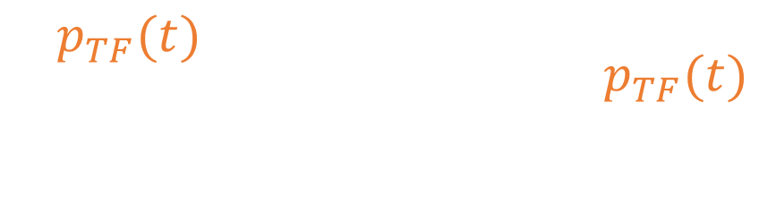
Mechanistic Model
mRNA $m_{TF}\left(t\right)$
$$\frac{ⅆp_{TF}(t) }{ⅆt}=s_{f}m_{TF}\left(t\right)−d_{f}p_{TF}(t)$$
Translation
TF Protein $p_{TF}(t)$
$$\frac{ⅆm_{i}(t)}{ⅆt}=s_{i}p_{TF}(t)−d_{i}m_{i}(t)$$
Transcription
Other mRNAs $m_{i}(t)$

Slide 7

Need to Model $p_{TF}(t)$
Gaussian process: a probabilistic model for functions.
Formally known as a stochastic process.
Multivariate Gaussian is normally defined by a mean vector, $μ$, and a covariance matrix, $\text{C}$.
$$y\sim N(μ,\text{C})$$
Gaussian process defined by a mean function, $μ(t)$, and a covariance function, $c(t,t^{′})$.
$$y(t)\sim N(μ(t),c(t,t^{′}))$$

Slide 8






Gaussian Processes
$$x_{1},y_{1}$$
$${x_{2},y}_{2}$$
$$p\left(f | x\right)$$
$$p\left(y_{1}|f_{1}\right)$$
$$p\left(f|y,x\right)$$
$$p\left(y_{2}|f_{2}\right)$$

Slide 9
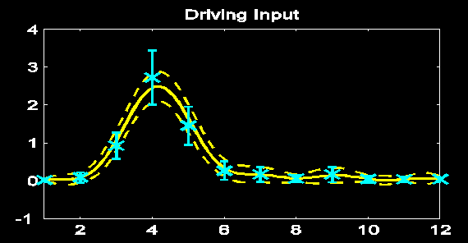
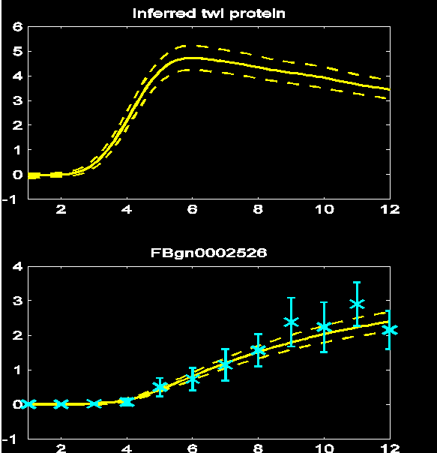
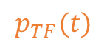




Results
$$m_{TF}\left(t\right)$$
$$\frac{ⅆp_{TF}(t) }{ⅆt}=s_{f}m_{TF}\left(t\right)−d_{f}p_{TF}(t)$$
$$p_{TF}(t)$$
$$\frac{ⅆm_{i}(t)}{ⅆt}=s_{i}p_{TF}(t)−d_{i}m_{i}(t)$$
$$m_{i}(t)$$
TPAMI, 2 PNAS papers, 2 Comp Bio

Slide 10
Further Challenge
This model inter-relates different functions with mechanistic understanding.
What if you need to inter-relate across different modalities of data at different scales.
E.g. images, high density touch sensors, torque force sensors

Slide 11
The Data are Not Enough
Four pillars:
Deterministic/Stochastic
Mechanistic/Empirical
Goal: model complex phenomena over time
Problem:
Mechanistic models are often inaccurate
Data is often not rich enough for an empirical approach
Question 2: How do we formulate the right representations to integrate different data modalities?

Slide 12


Classical Latent Variables
$$\text{x}$$
$$\text{y}$$

Slide 13

Classical Treatment
Assume a priori that
$$x\sim N\left(0,I\right)$$
Relate linearly to $\text{y}$
$$\text{y} \text{=} \text{Wx} \text{+}ε$$
Framework covers many classical models PCA, Factor Analysis, ICA

Slide 14
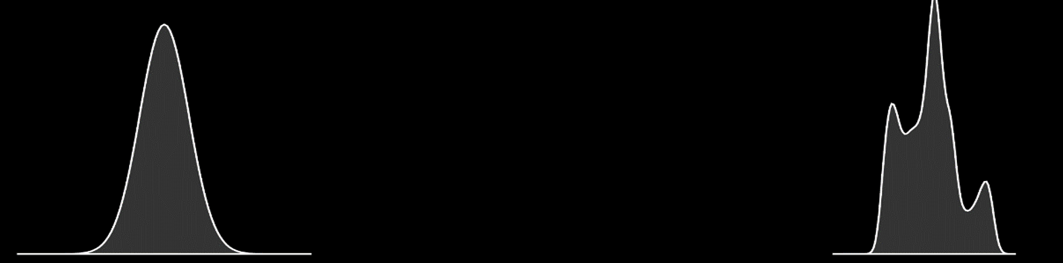

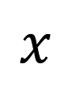
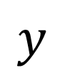
Render Gaussian Non Gaussian
$$y=f(x)$$
$$x$$
$$y$$
Notes:
In practice, many things are non gaussian, here I’ll introduce the idea of process composition: deep Gaussian processes, which we intend to use to deal with the Non Gaussian and abstract nature of the data. I’ll relate it to the OSI model and suggest that abstraction in this way, with propagation of uncertainty is a promising approach to phenomological modelling at multiple levels.

Slide 15
Use Abstraction for Complex Systems
High Level Ideas
Stratification of Concepts
Low Level Mechanisms
Notes:
In this slide I’m going to use the layered model of network systems to describe the challenges of understanding complex systems in the physical world such as biological systems and neuroscience. I’ll give an analogy: imagine trying to understand the internet when you only have measurements of the cables and access to YouTube.

Slide 16
$\text{g}\left(x\right)$
${\text{f}}_{1}(x)$
${\text{f}}_{2}(∙)$
${\text{f}}_{3}(∙)$
${\text{f}}_{4}(∙)$
${\text{f}}_{5}(∙)$
${\text{f}}_{6}(∙)$
${\text{f}}_{7}(∙)$
${\text{f}}_{8}(∙)$
${\text{f}}_{9}(∙)$
$\text{g}\left(x\right)={\text{f}}_{9}\left({\text{f}}_{8}\left({\text{f}}_{7}\left({\text{f}}_{6}\left(⋯\right)\right)\right)\right)$

Slide 17
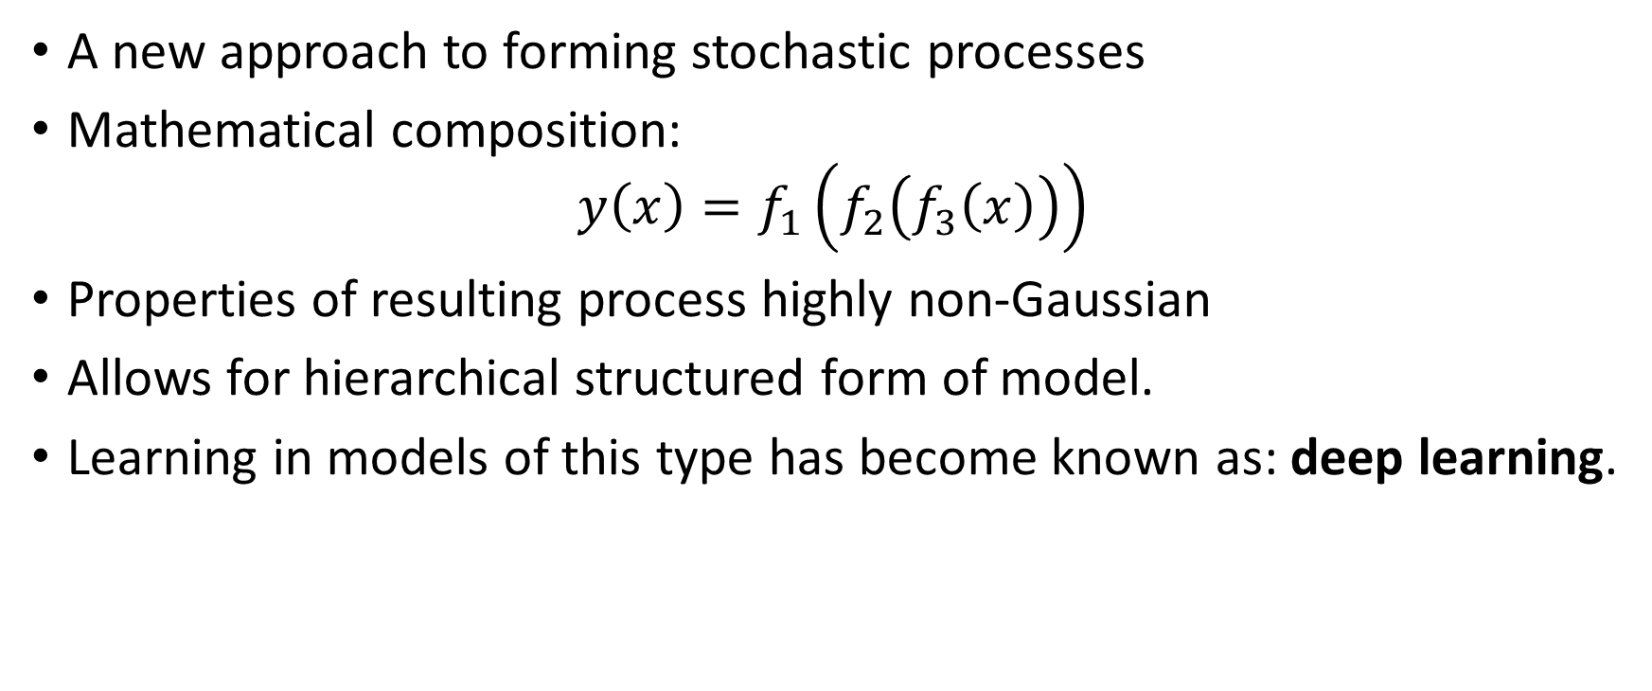
Stochastic Process Composition
A new approach to forming stochastic processes
Mathematical composition:
$$y\left(x\right)=f_{1}\left(f_{2}\left(f_{3}\left(x\right)\right)\right)$$
Properties of resulting process highly non-Gaussian
Allows for hierarchical structured form of model.
Learning in models of this type has become known as: deep learning.
Notes:
Non Gaussianity and structure achieved through the process of stochastic process composition. Leads to more flexible familiies of processes which can express more interesting beliefs about the system. Can be made to closely reflect the abstraction structure we referred to before.

Slide 18
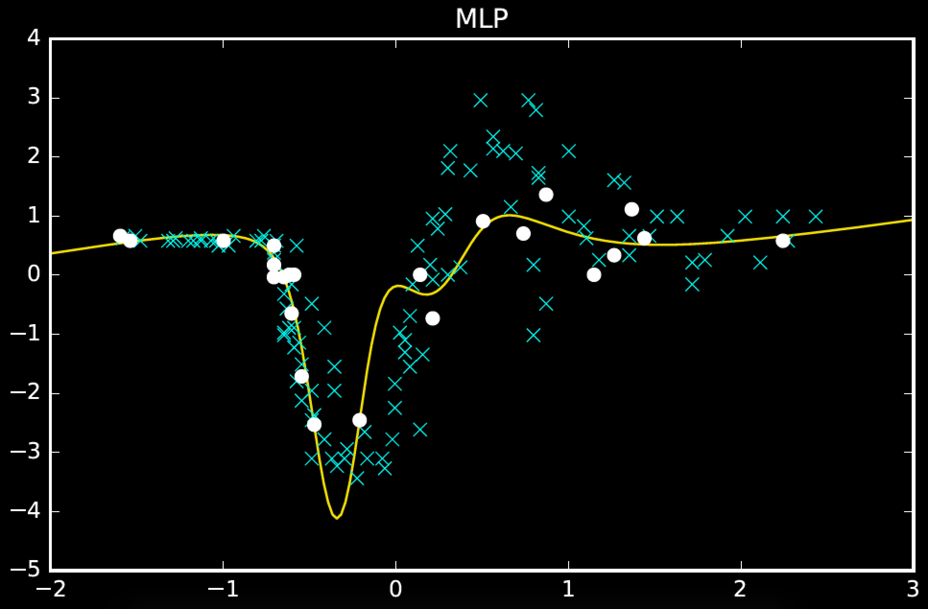
(200 iterations)

Slide 19
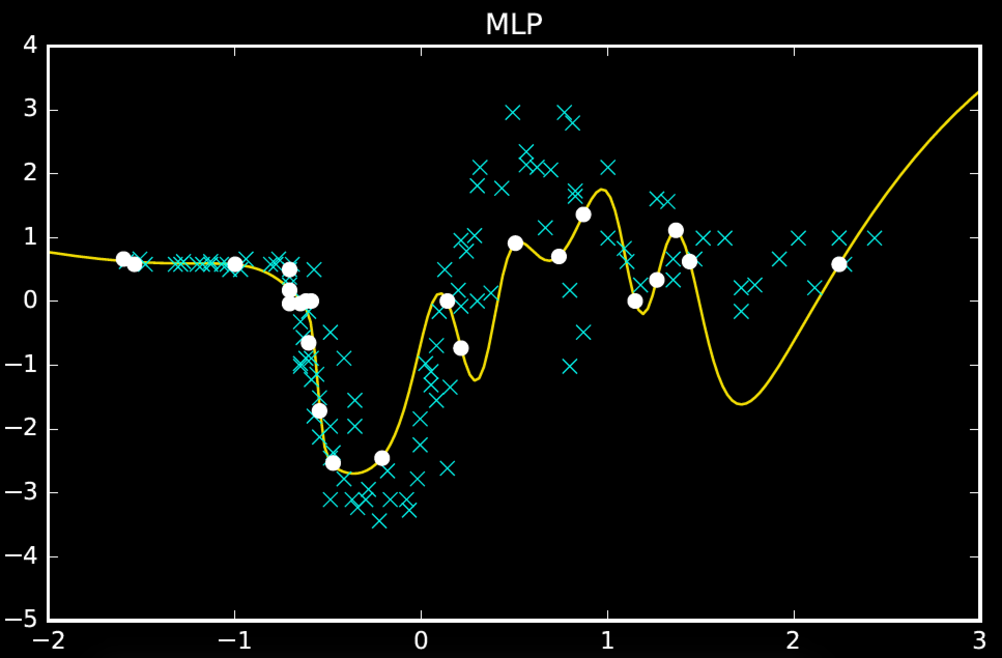
(converged)

Slide 20
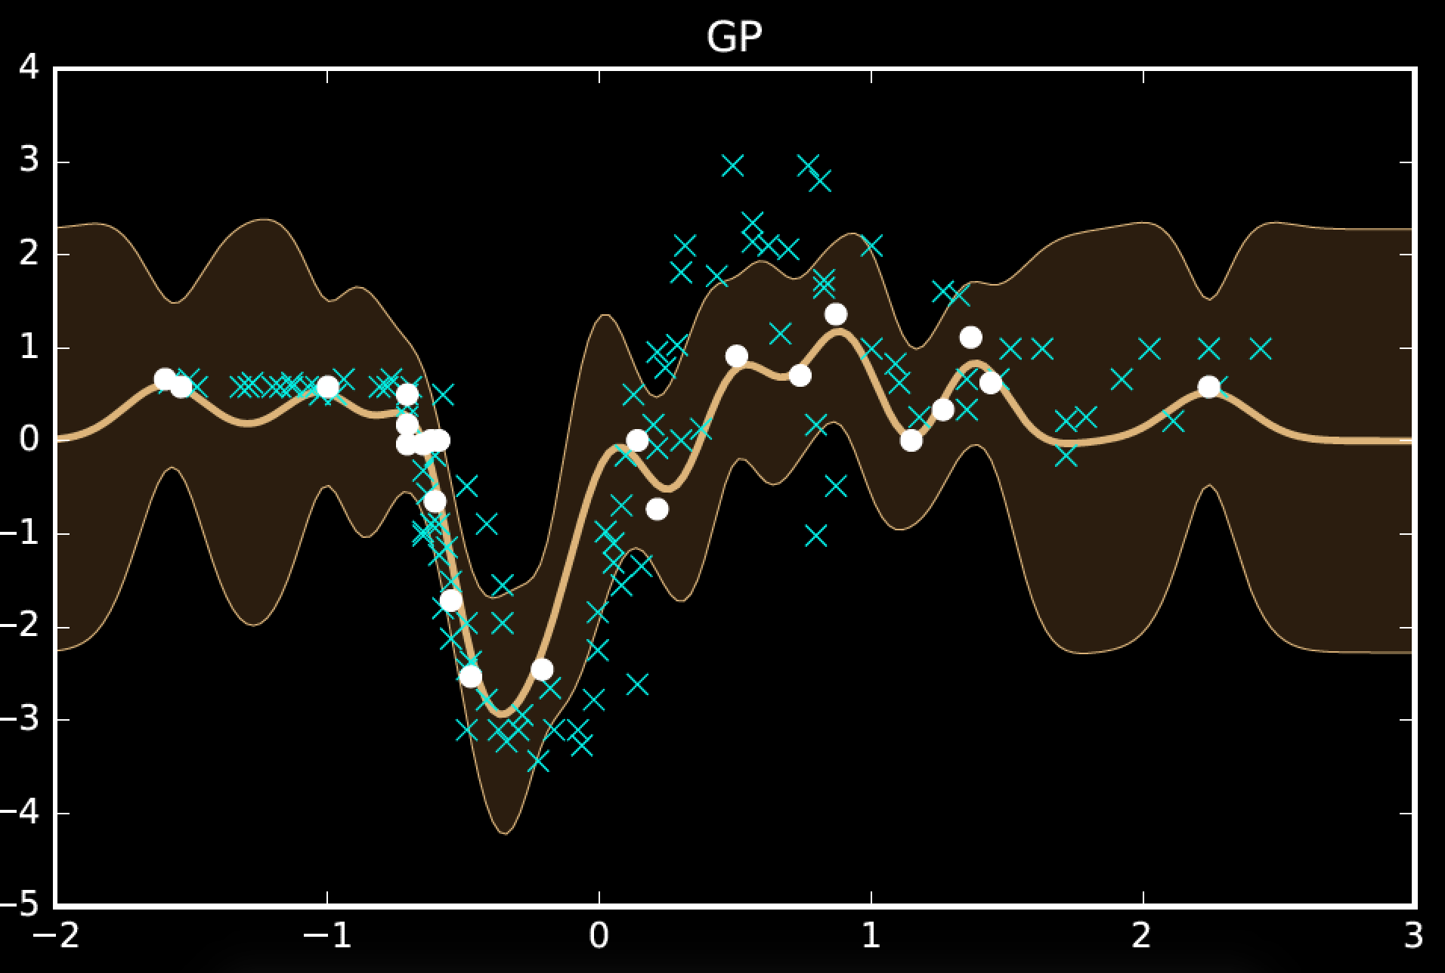

Slide 21
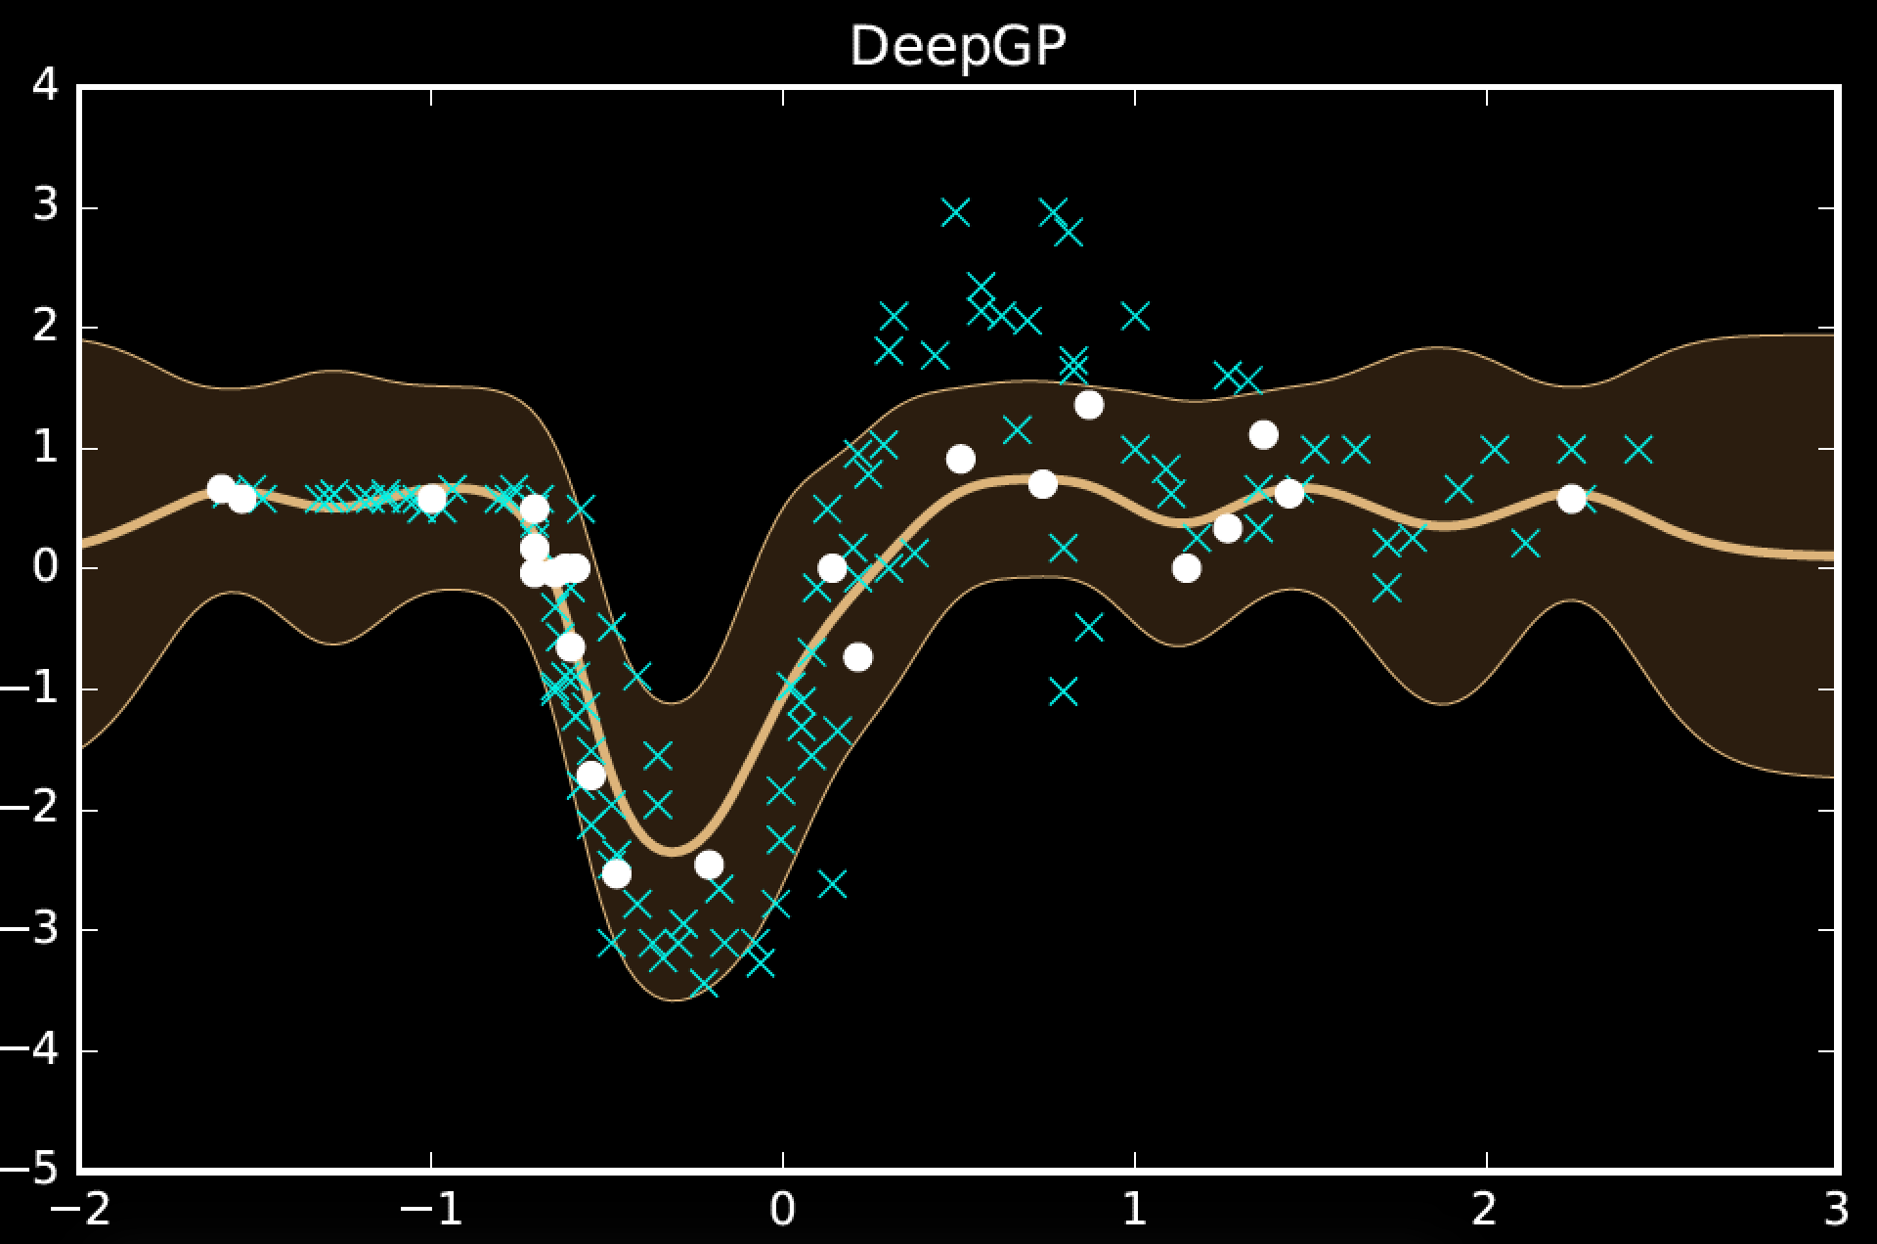
2

Slide 22
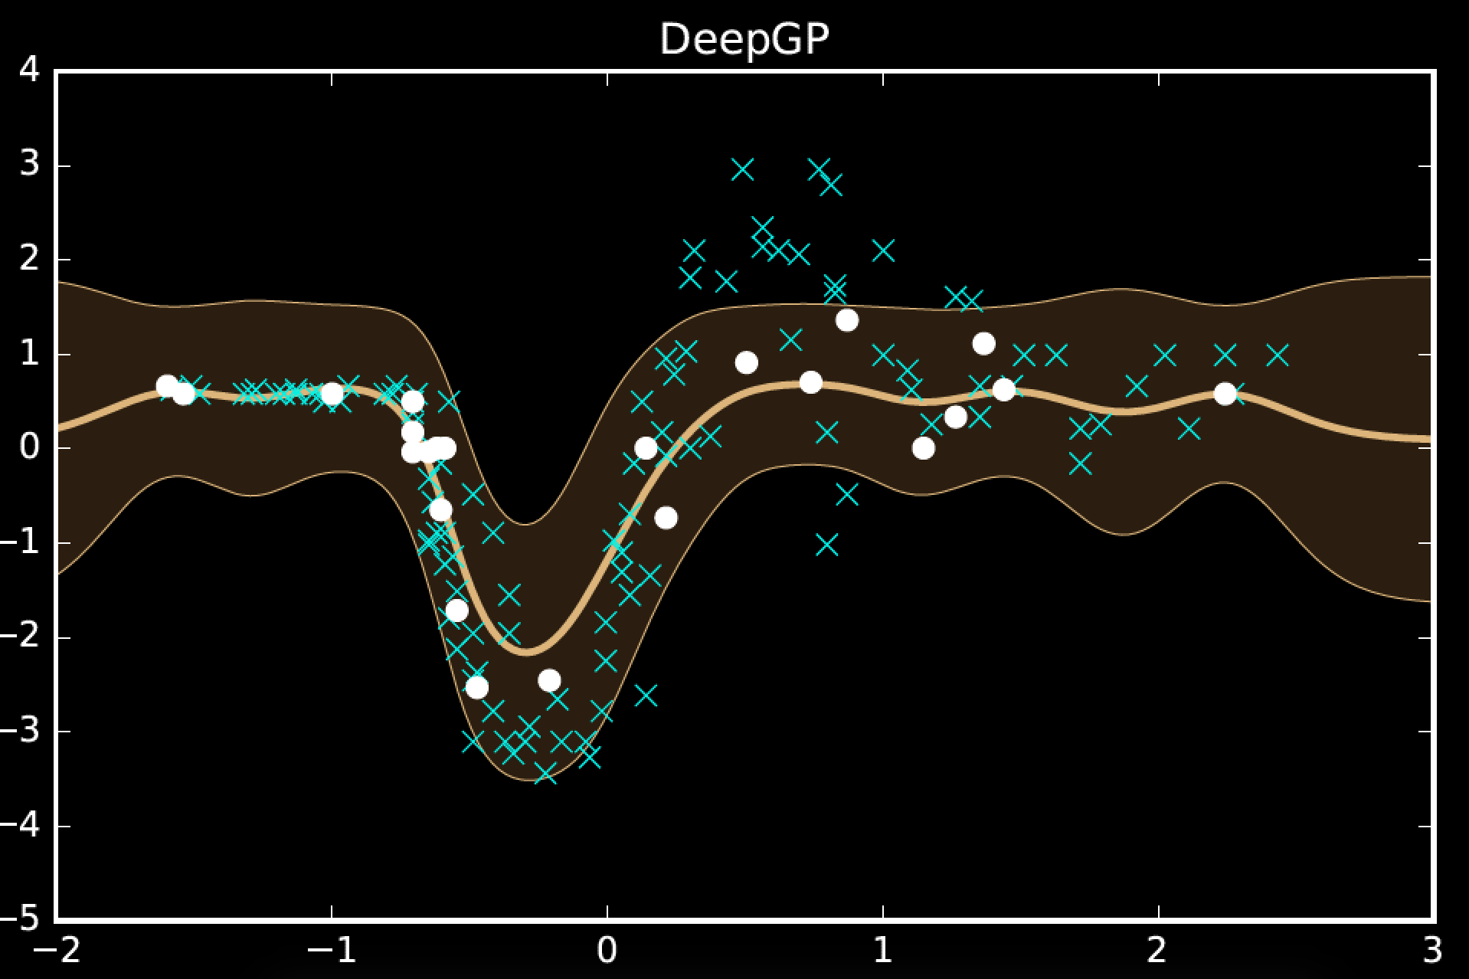
3

Slide 23
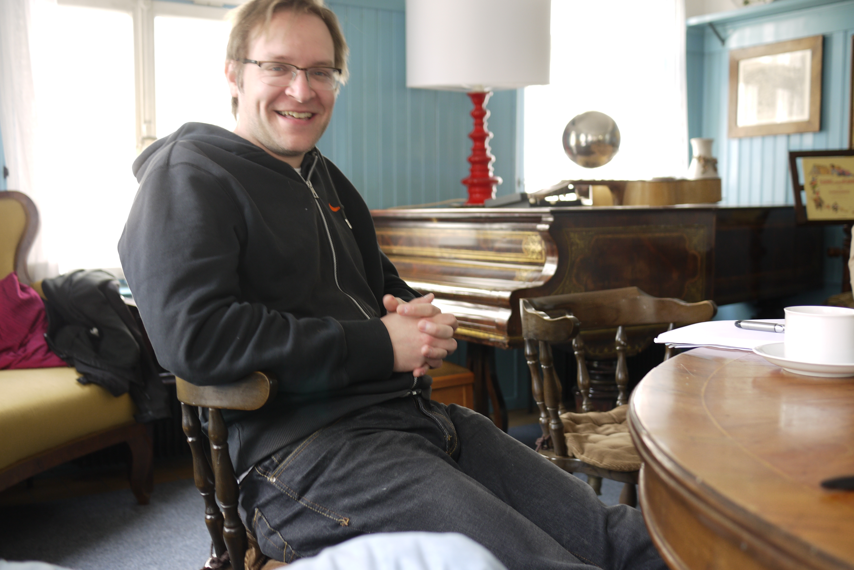
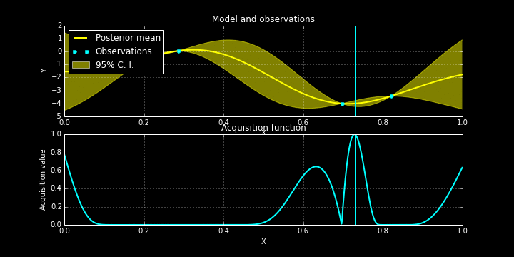
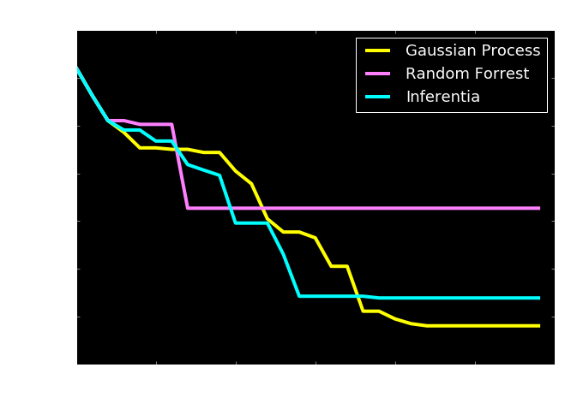
Bayesian Optimization
Check http://sheffieldml.github.io/GPyOpt/

Slide 24
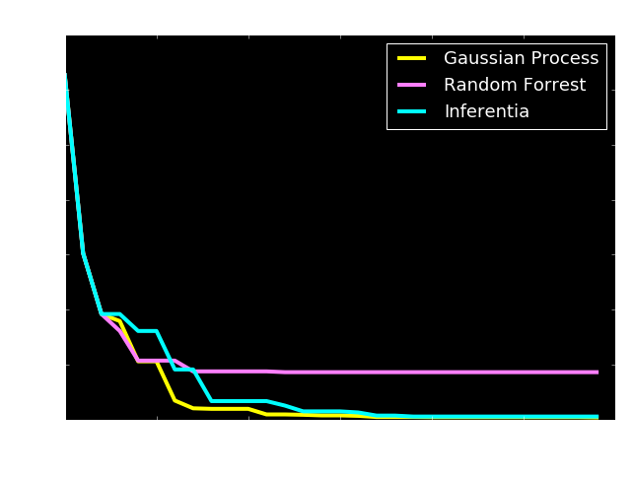
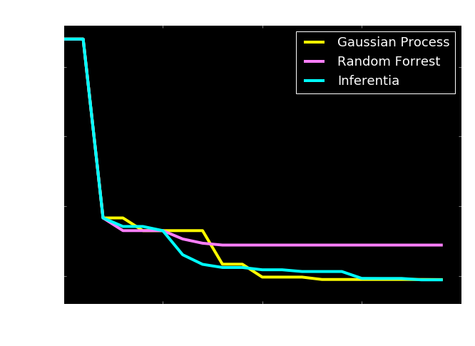
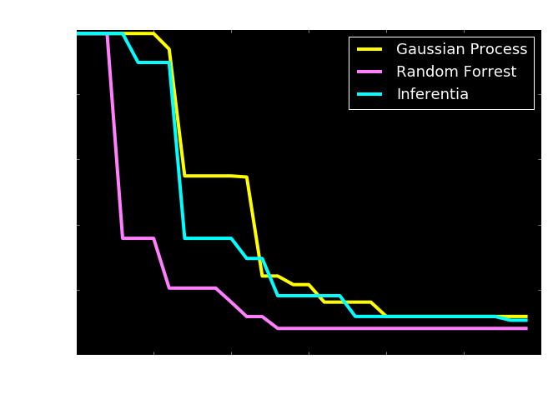
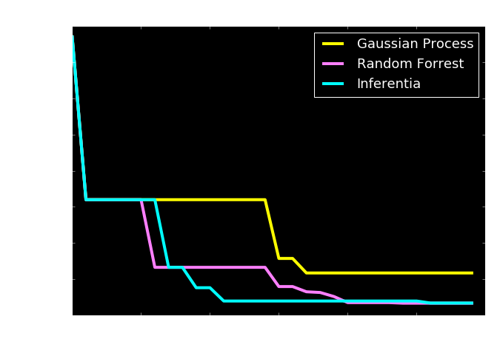

Slide 25
Use Abstraction for Complex Systems
High Level Ideas
Stratification of Concepts
Low Level Mechanisms
Notes:
In this slide I’m going to use the layered model of network systems to describe the challenges of understanding complex systems in the physical world such as biological systems and neuroscience. I’ll give an analogy: imagine trying to understand the internet when you only have measurements of the cables and access to YouTube.

Slide 26
Example: Motion Capture Modelling
Notes:
I’ll give a quick demonstration of the deep Gaussian process (or show a video) probably on the motion capture. This one involves walkers and runners.

Slide 27
Recently
Gaussian Process Summer School
12th-15th September 2016 in Sheffield
This year in parallel with/themed as a UQ orientated school (co-organisation with Rich Wilkinson)
http://gpss.cc/

Slide 28
Summary
Complex systems:
‘big data’ is too ‘small’.
The data are not enough.
Need data efficient methods
http://www.theguardian.com/media-network/2016/jan/28/google-ai-go-grandmaster-real-winner-deepmind
Solutions:
Hybrid mechanistic-empirical models
Structured models for automated data assimilation

Slide 29
People
Carl Rasmussen (Cambridge)
Marc Deisenroth (Imperial)
Philipp Hennig (MPI Tuebingen)
Mike Osbourne (Oxford)

Slide 30
Thank you
Neil Lawrence
http://inverseprobability.com
@lawrennd
Notes:
Thank you.

